Slide 1
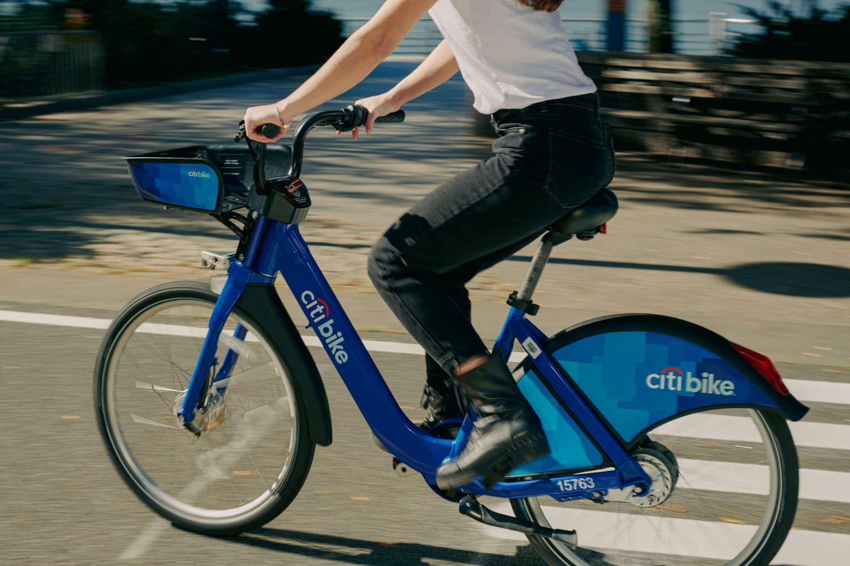
Case Study: Citi Bike
Group No. 4
Anasuya Sikdar
Maria Solis Galan
Nikita Sahu
Amartya Reddy
Kusum Lnu

Slide 2
Case Overview
What is Citi Bike?
Bike share system
Offers: single rides, day pass, and memberships (NYC only)
25,000 bikes in over 1,500 stations located across:
Manhattan, Brooklyn, Queens, the Bronx, Jersey City, Hoboken
Problem? Imbalanced stations > revenue loss, high logistic costs
Data: NYC Citi Bike
Objective:
Determine the optimal number of bikes to allocate to each station at the beginning of the day to maximize the number of daily trips
Questions:
Each day (during Morning and Evening), how many trips are made between the stations?
Is the demand constant throughout the year or which factors affect it?
How many bikes should we deploy at each selected station to maximize number of trips?

Slide 3
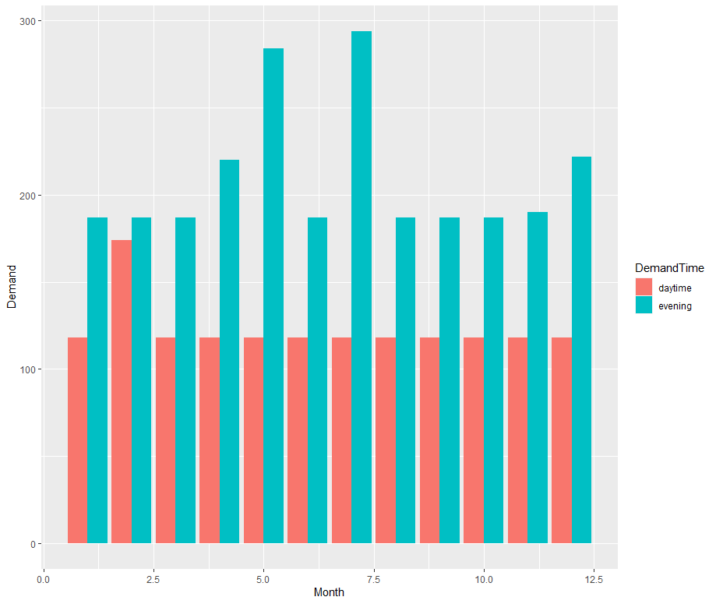
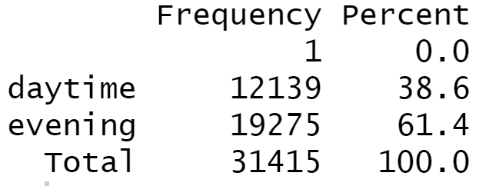
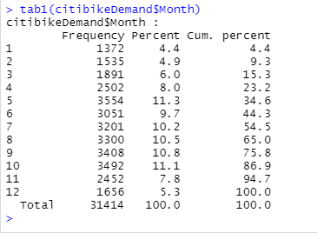
NY Citi Bike Data
Overall: 31,414 observation with 25 variables
Data considers demand based on day of week, month, income, weather factors, location, distance.
June 1st, 2017 to May 31st, 2018
Demand fluctuates depending on the month and day of week.
"Demand" is the Response.
1 2 3 4 5 6 7 8 9 10 11 12

Slide 4
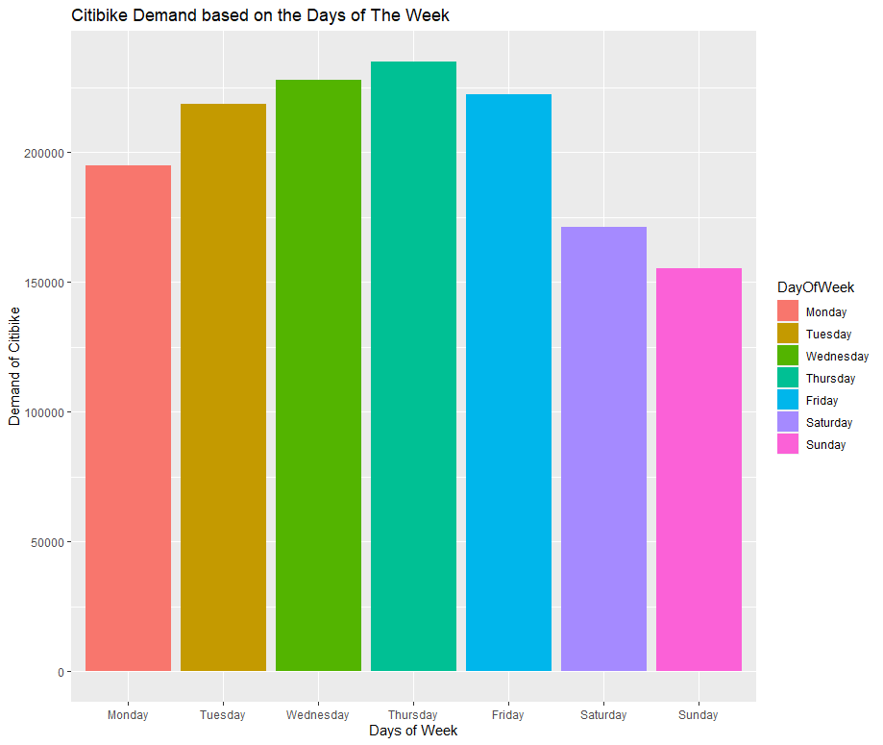
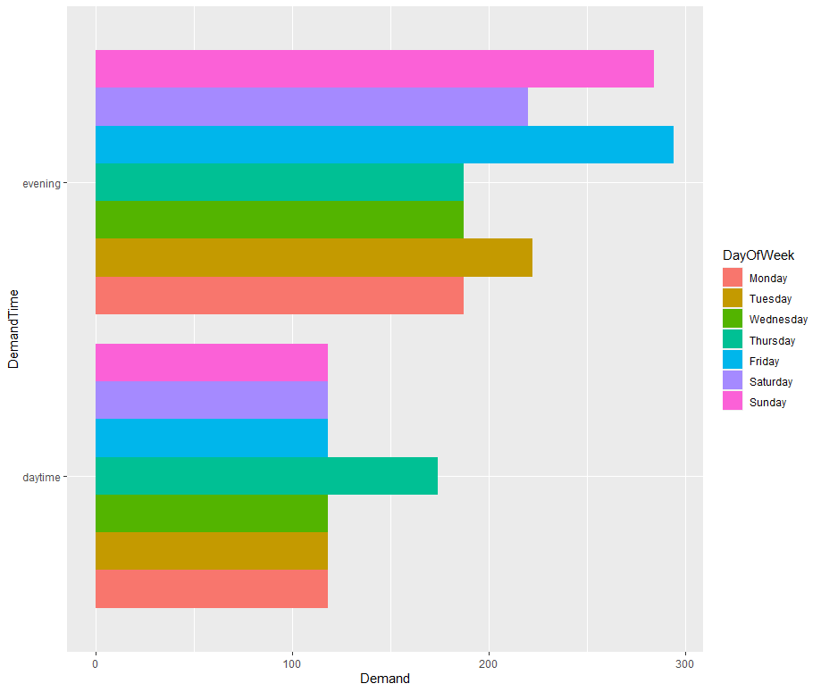
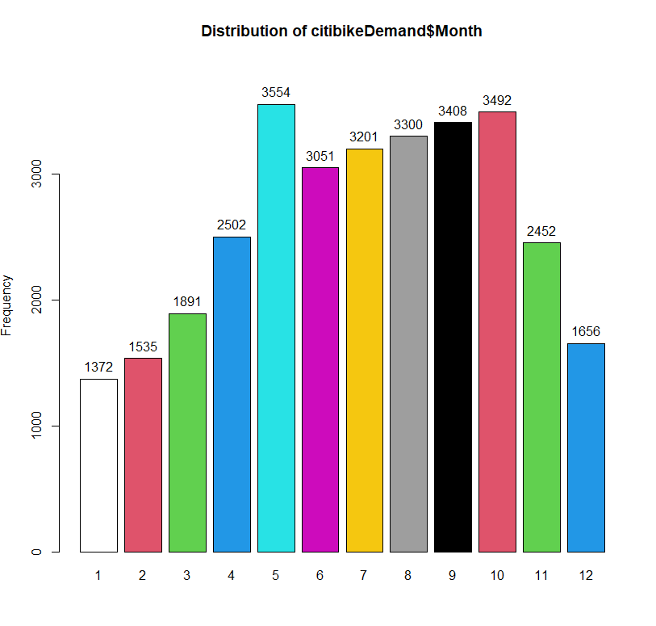

Demand distribution based on days of the week, time, and month
Overall highest demand
Week:
Thursday daytime
Wednesday evening
Friday evening
Overall highest demand
Month:
May – 3554
October – 3492
September - 3408
Descriptive Analysis and Visualization

Slide 5
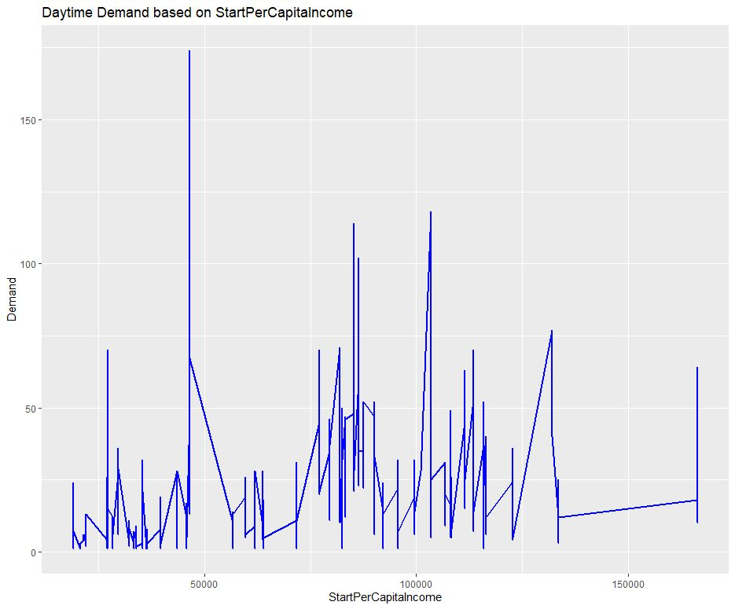
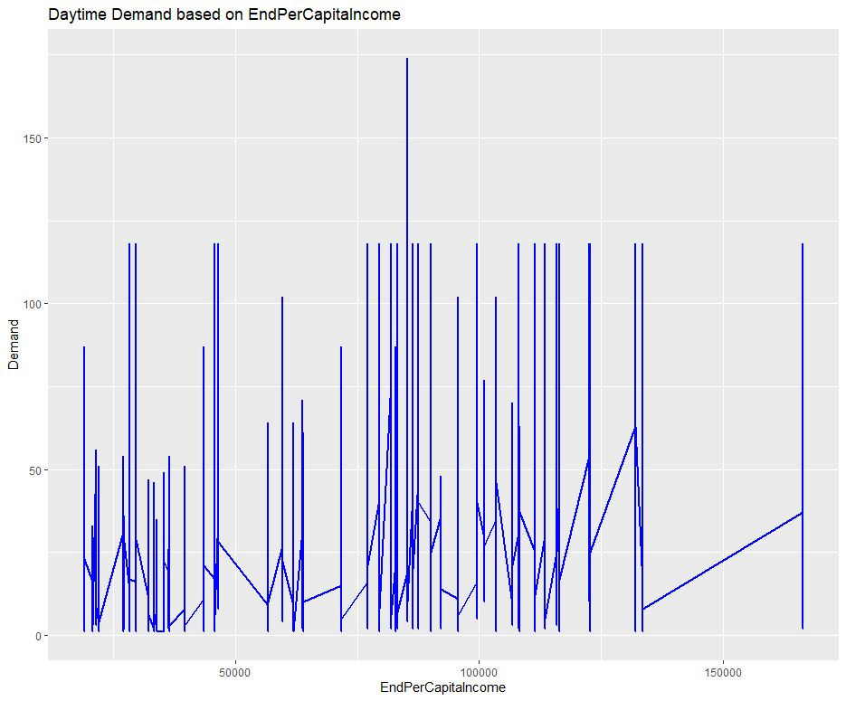
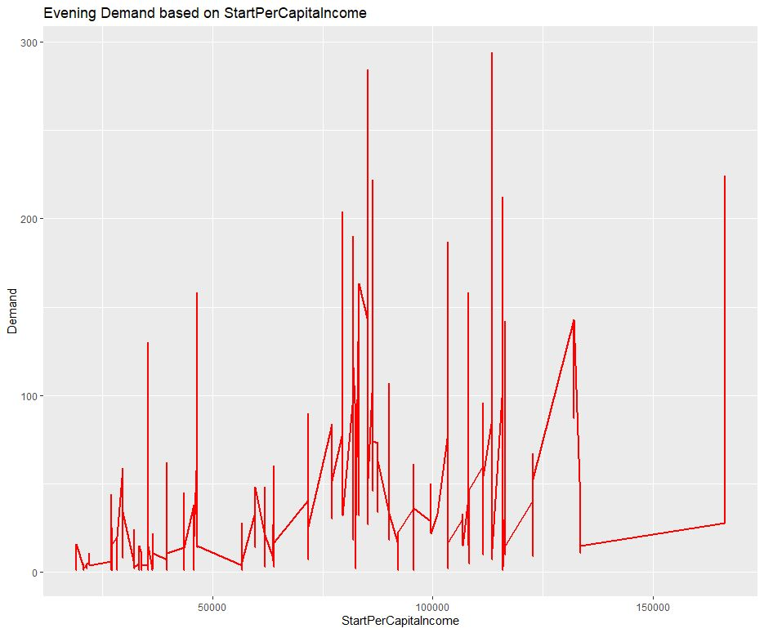
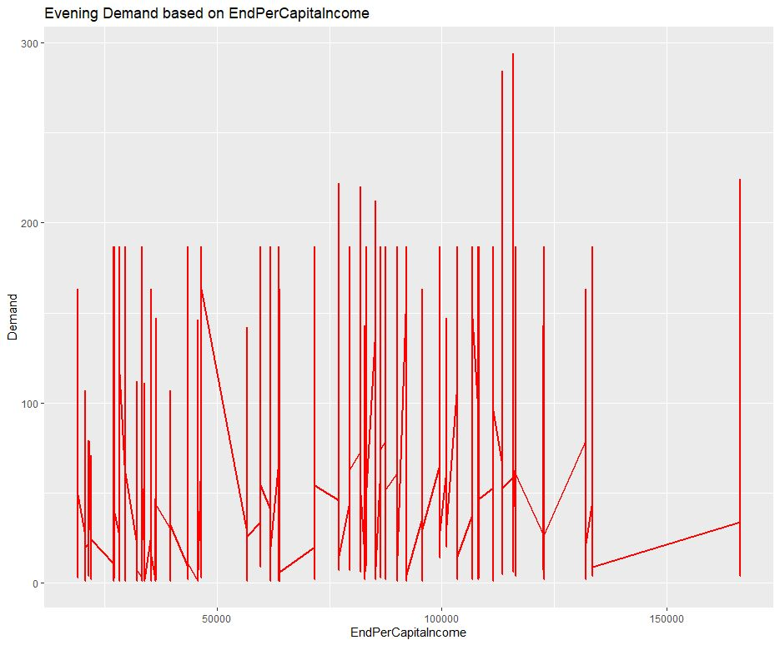
Daytime and Evening Demand based on Start Per Capita Income
Daytime and Evening Demand based on End Per Capita Income

Slide 6
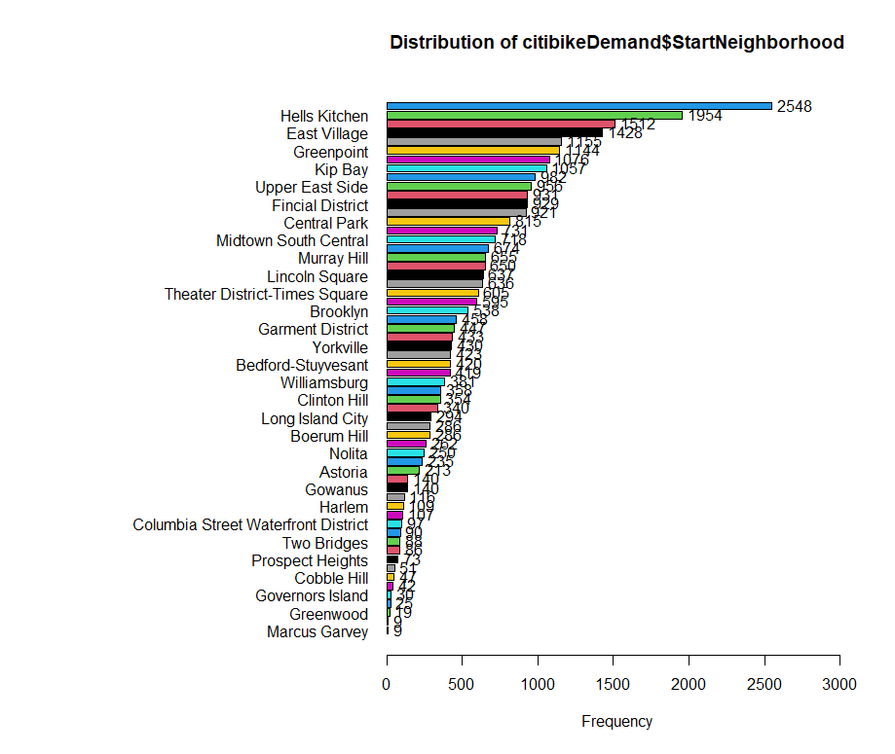
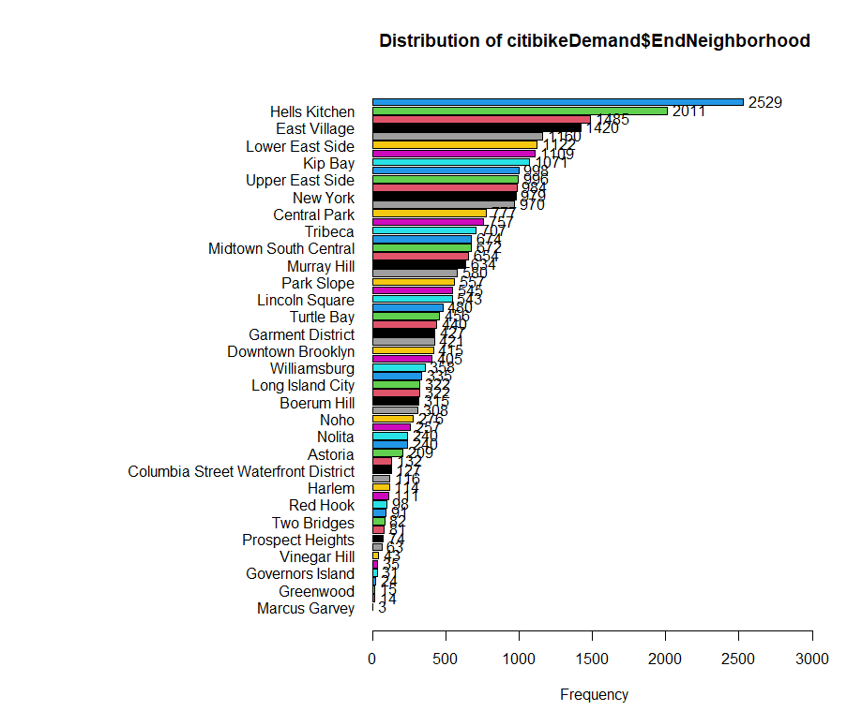
Demand based on Start and End Neighborhood
Overall highest demand found in:
Hells Kitchen
East Village
Kip Bay
Upper East Side
Central Park
Notes:
Hells Kitchen – 2548, 2529
East Village – 1954, 2011
Kip Bay – 1428, 1420
Upper East Side – 1155, 1160
Central Park – 1076, 1109

Slide 7

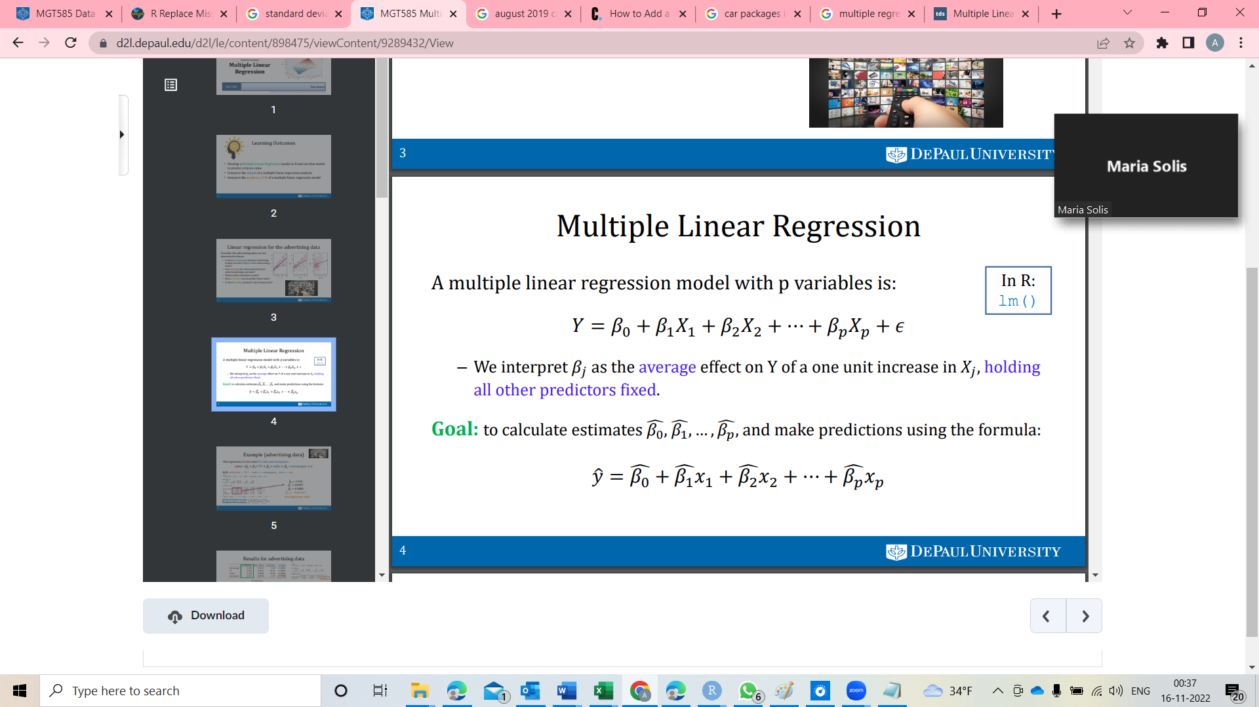
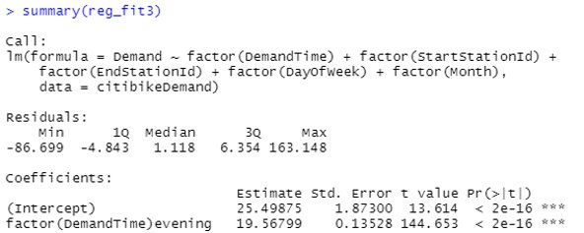
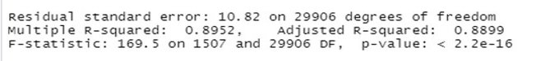
Predictive Analysis
R Code of Multiple Linear regression Model
Mathematical Representation of Multiple Linear Regression Model
Model Goodness of Fit
Quantity | Value
RSE | 10.82
R-Squared | 0.8952
F-statistic | 169.5
P-value | <2.2e-16

Slide 8

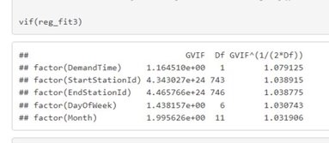


Variance Inflation Factor
-used to check for Multicollinearity Problem in the model
- If vif > 5 or 10 denote model has problems estimating the coefficient
What do we Infer from the Table?
- value of vif between 1-5, moderate correlation
(good value)

Slide 9

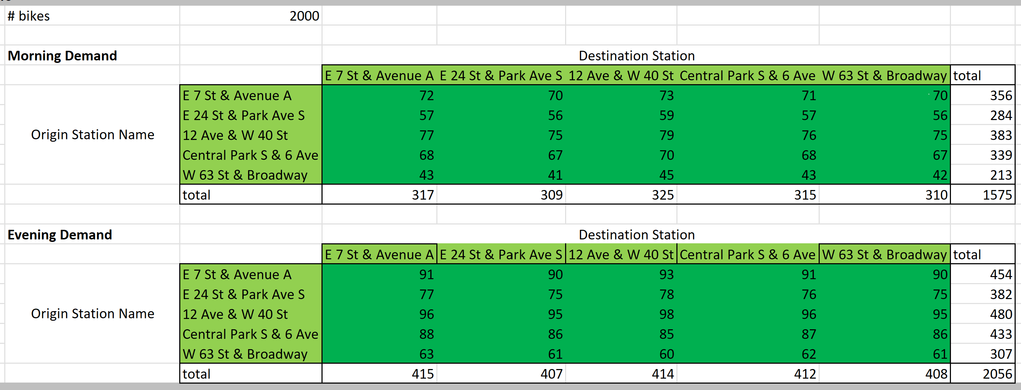
Prescriptive Analysis
Selected Stations
E 7 St & Avenue A > East Village
E 24 St & Park Ave S > Midtown South Central
12 Ave & W 40 St > Hells Kitchen
Central Park S & 6 Ave > Central Park
W 63 St & Broadway > Lincoln Square

Slide 10
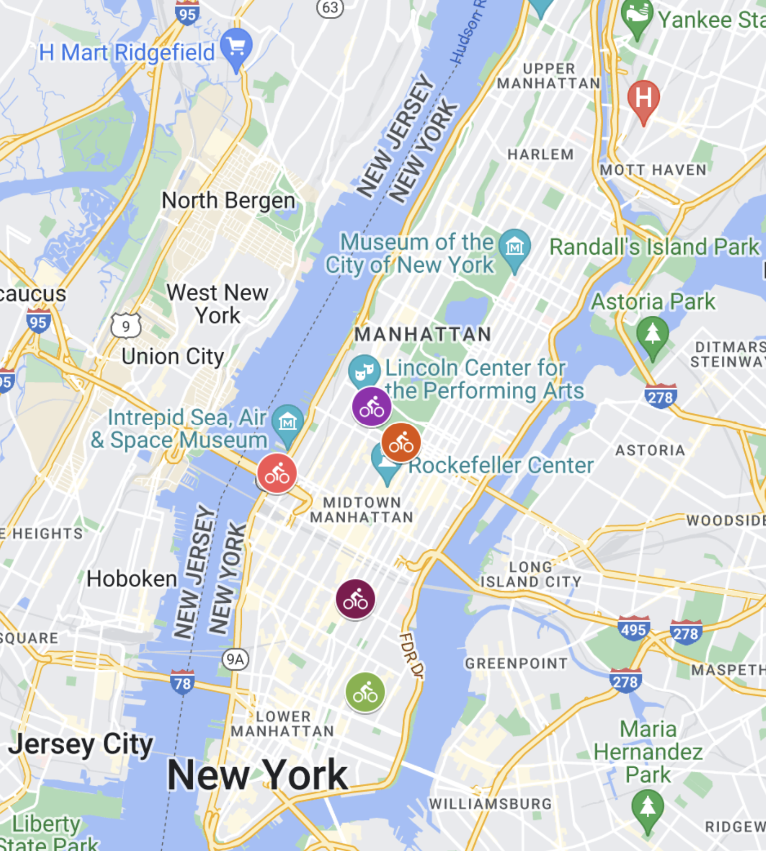
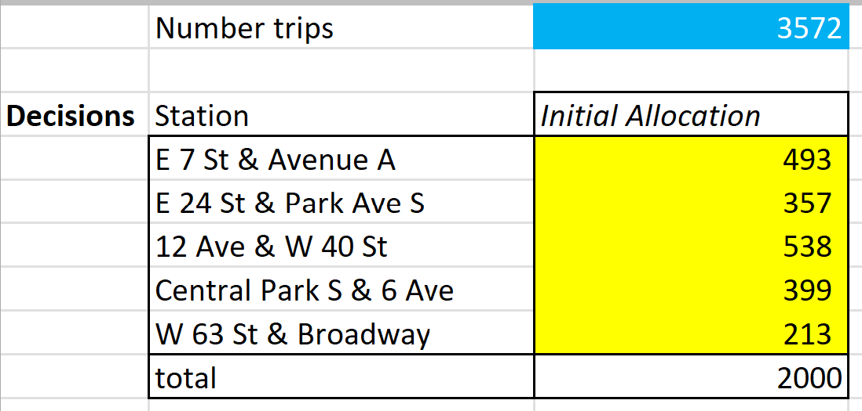
Selected stations and allocation for each
E 7 St & Avenue A - 493
E 24 St & Park Ave S – 357
12 Ave & W 40 St - 538
Central Park S & 6 Ave – 399
W 63 St & Broadway - 213
W 63 St & Broadway
12 Ave & W 40 St
Central Park S & 6 Ave
E 24 St & Park Ave S
Max Number of Trips: 3572
E 7 St & Avenue A

Slide 11
Recommendation
Station ID | Station Name | Neighborhood | Initial Allocation
432 | E 7 St & Avenue A | East Village | 493
491 | E 24 St & Park Ave S | Midtown South Central | 357
514 | 12 Ave & W 40 St | Hells Kitchen | 538
2006 | Central Park S & 6 Ave | Central Park | 399
3158 | W 63 St & Broadway | Lincoln Square | 213
Allocation of 2000 bikes in order to satisfy 3572 trips between these stations.
Overall bike allocation:
Consider demand levels in each neighborhood and assign trucks to restock bikes based on neighborhood demand.
Set number of bikes to be allocated to each neighborhood and adjust on Monthly basis according to Demand fluctuations.
Notes:
Determine the optimal number of bikes to allocate to each station at the beginning of the day to maximize the number of daily trips
Consider demand levels in each neighborhood and assign trucks to restock bikes based on neighborhood demand.
Not based on station demand.
This in order to avoid logistic cost of moving bikes daily from one neighborhood to another. Instead set a fixed allocation per neighborhood (not per station)
It is easy to walk from one station to another if in the same neighborhood and the consumers’ willingness might not decrease as much as when asked to move from their neighborhood to another to be able to use a bike.
Set number of bikes to be allocated to each neighborhood and adjust on a monthly basis according to demand fluctuations.
We see that even though overall demand decreases certain months, the neighborhoods considered as ‘high demand’ remain that way even in months as January when overall demand decreases.

